Slide 1
Temperature

Slide 2
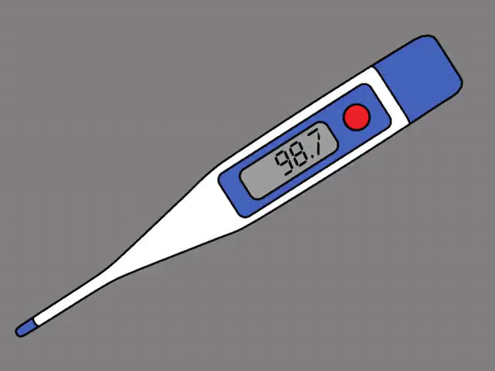
In this Smart Lesson you will learn to:
Understand temperature scales and how to convert between Celsius and Kelvin.
Describe how to record temperature, including considering uncertainty of measurements.
Explain the concept of temperature change in terms of energy.

Slide 3
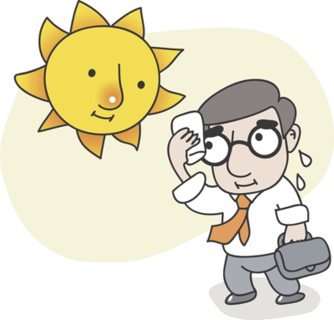
In everyday language we often use heat and temperature interchangeably.
However, in physics these two terms have different meanings.
Temperature is the average kinetic energy of particles in a body.
Heat is thermal energy which is transferred from one body to another due to temperature difference. Adding heat energy to a body causes the particles to vibrate faster, increasing the temperature of the body.

Slide 4
We have three scales for measuring temperature.
These are the Kelvin scale, Celsius scale, and Fahrenheit scale.
The Celsius scale has units ∘C. The freezing point of water is 0∘C and the boiling point of water is 100∘C. This is the scale we use most often in our everyday lives.
The Kelvin scale has units K. At absolute zero (0 K), atoms stop moving, because they have no kinetic energy. An interval of 1 K is equal to an interval of 1∘C. A temperature of 0 K is equivalent to −273.15∘C.
The Fahrenheit scale is another way of measuring temperature. The USA is the only major country which uses it, and the Fahrenheit scale is not used in scientific writing.

Slide 5
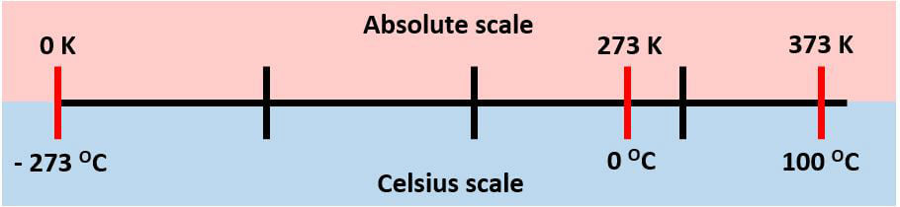
In both the absolute scale and the Celsius scale, one degree is the same change in temperature.
The Celsius scale is based on properties of water, whilst the absolute scale is based on energy of the particles.

Slide 6
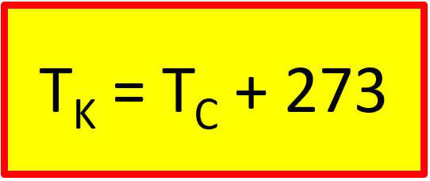
Converting between Celsius and Kelvin.
Where T_{K​} is the temperature in Kelvin and T_{C}​ is the temperature in Celsius.
For example, what temperature in Kelvin does water boil at?
T_{C}​=100∘C
T_{K}​=100+273
T_{K​}=373 K

Slide 7
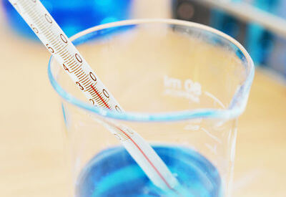
Temperature can be measured using various measuring devices.
In the lab you commonly will use an alcohol thermometer or digital thermometer. It is important that you know how to use it correctly and how to work out the measurement uncertainty (absolute and percentage).

Slide 8

A thermometer is filled with red coloured alcohol that expands as it gets hotter.
The level this red fluid reaches gives you the temperature.
It is measured in degrees Celsius (∘C).

Slide 9
When we are collecting data, every measurement has an intrinsic limit to the number of digits that can be recorded, called the Limit of Reading.
We can't measure to less decimal places, so the measurement could potentially vary from the reading by the value of the limit of reading.
For example, when using an electronic thermometer, it commonly measures to the nearest 0.1∘C.
To show that a reading is accurate to within 0.1∘C, we use the ± symbol. For example, a reading could be 36.5 ± 0.1∘C.
The range is from (36.5−0.1) to (36.5+0.1) ∘C.
This means the temperature is between 36.4 and 36.6∘C.

Slide 10
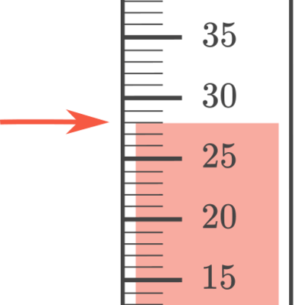
Reading an alcohol thermometer.
In the thermometer below, the reading is taken at the point where the arrow is marking, so is 28∘C.
Each division on the thermometer is 1∘C, so we take the uncertainty as being half of the division, so it would be ±0.5∘C.
We would write the reading with the uncertainty as 28.0 ± 0.5∘C.
This means the actual reading is between 27.5∘C and 28.5∘C.

Slide 11
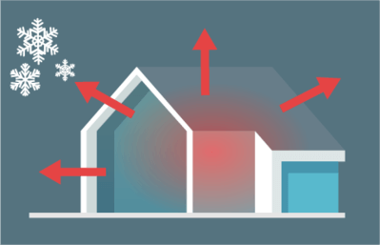
A change in temperature is due to the addition or removal of energy from a system (without phase change.)
The energy in a system due to the movement of particles is thermal energy.
When thermal energy is transferred from one place to another, it is called heat.
Heat moves from areas of higher to lower temperature (average kinetic energy of particles).

Slide 12
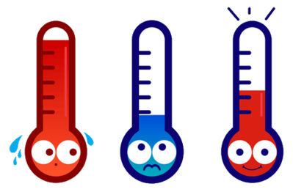
Heat transfer is the movement of heat from one object to another object.
This heat always flows from the hotter object to the colder object.
This heat transfer is fastest when there is a large temperature difference.

Slide 13
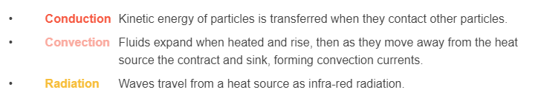
There are three types of heat transfer:

